Slide 1

CNN for Computer Vision
서용덕
yndk@sogang.ac.kr

Slide 2
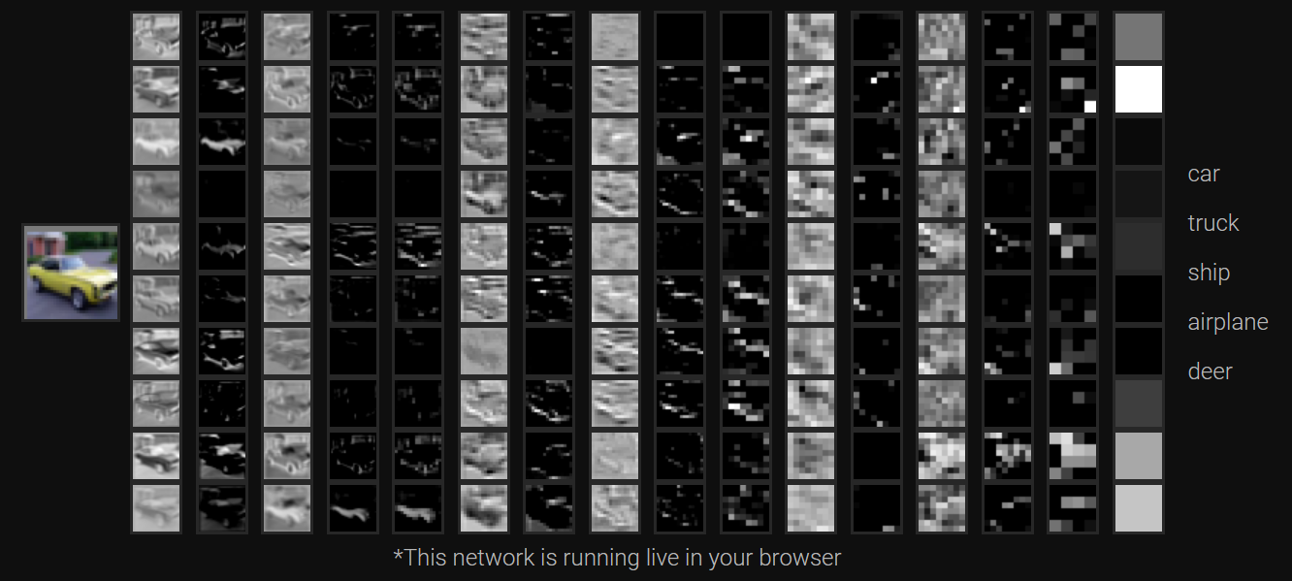
http://cs231n.stanford.edu/
- http://cs231n.stanford.edu/schedule.html

Slide 3
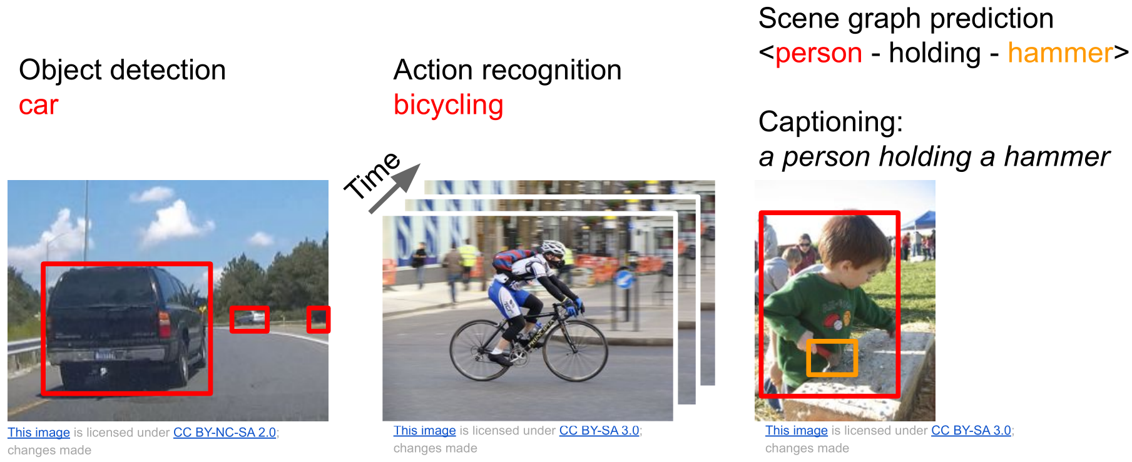
There are many visual recognition problems that
are related to image classification, such as
object detection, image captioning, semantic
segmentation, visual question answering, visual
instruction navigation, scene graph generation

Slide 4
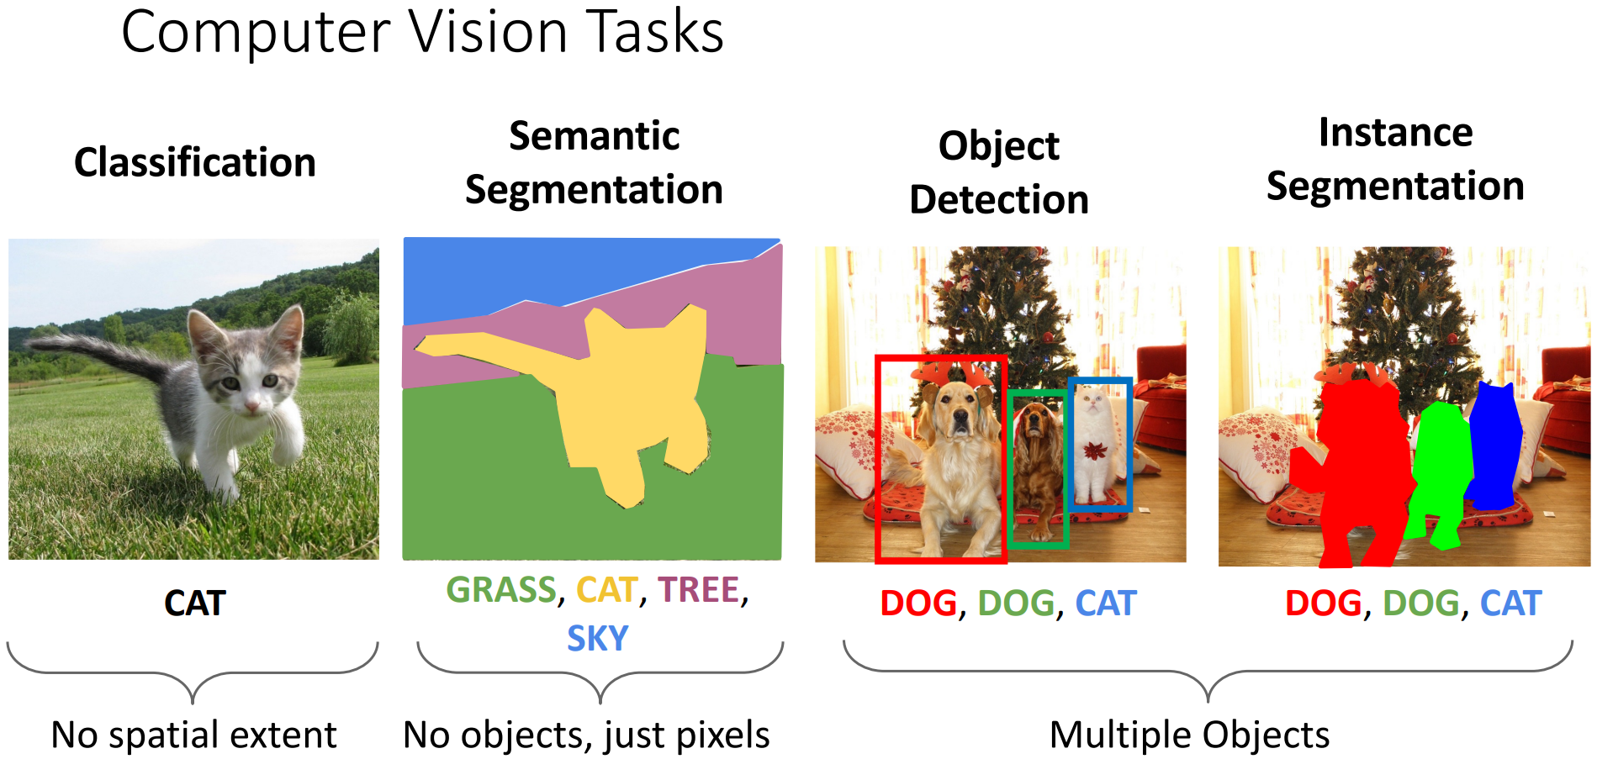
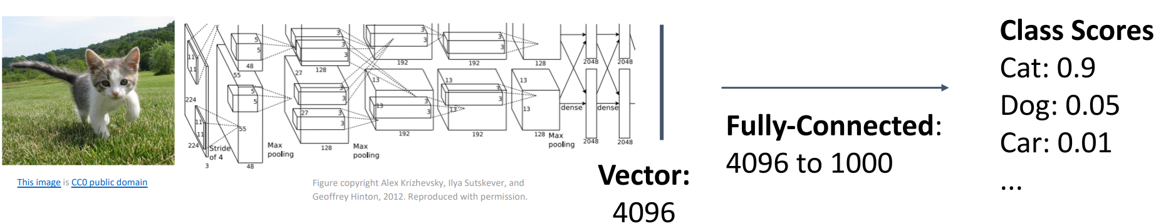

Slide 5
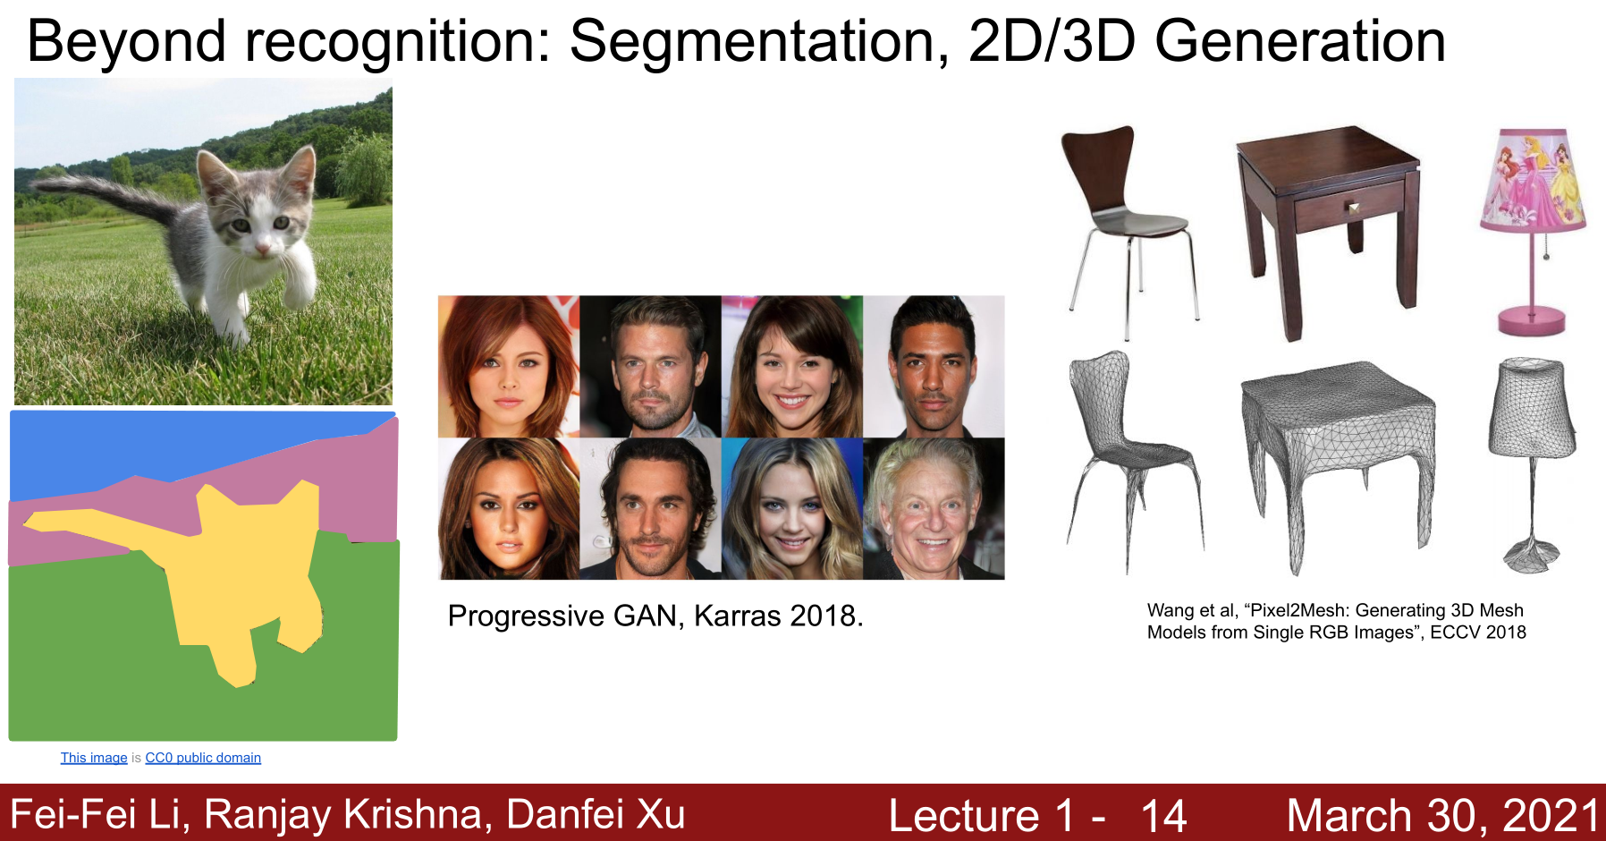

Slide 6
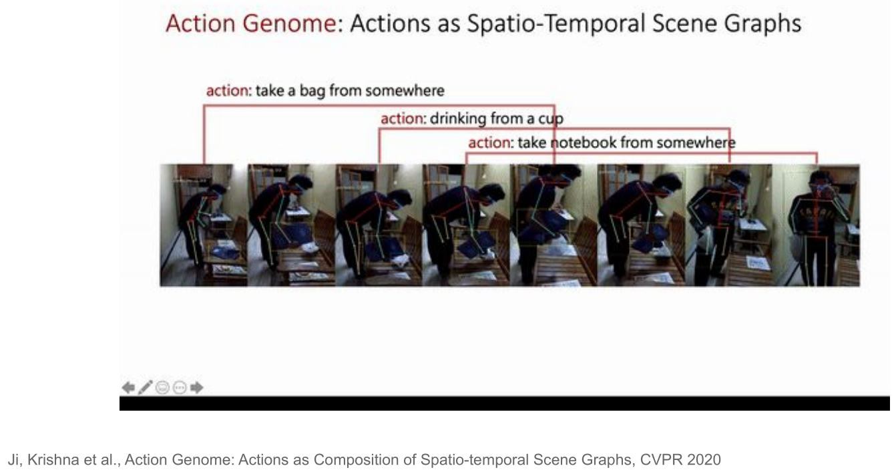

Slide 7
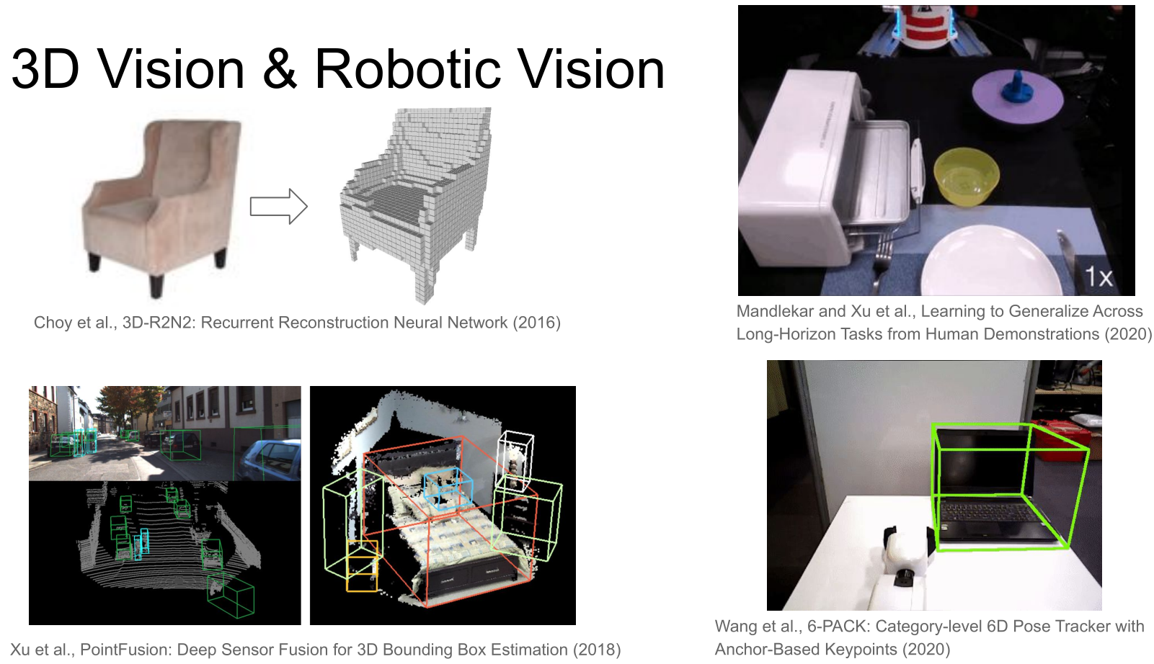

Slide 8


Slide 9
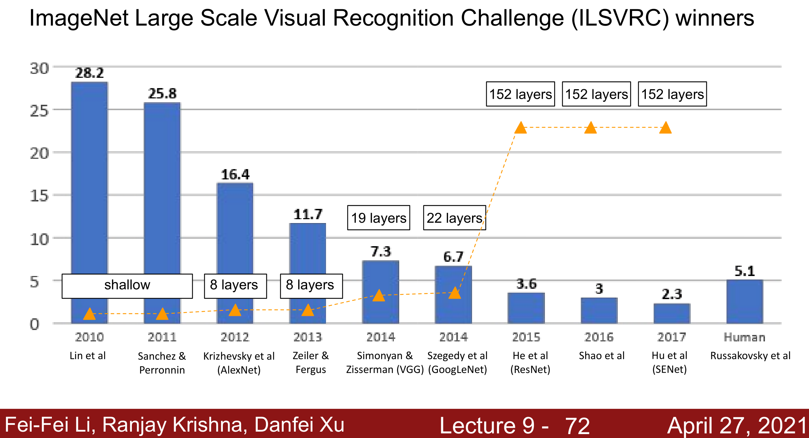
http://cs231n.stanford.edu/schedule.html,
Justin Johnson, U-Michgan, https://www.youtube.com/watch?v=XaZIlVrIO-Q&list=PL5-TkQAfAZFbzxjBHtzdVCWE0Zbhomg7r

Slide 10
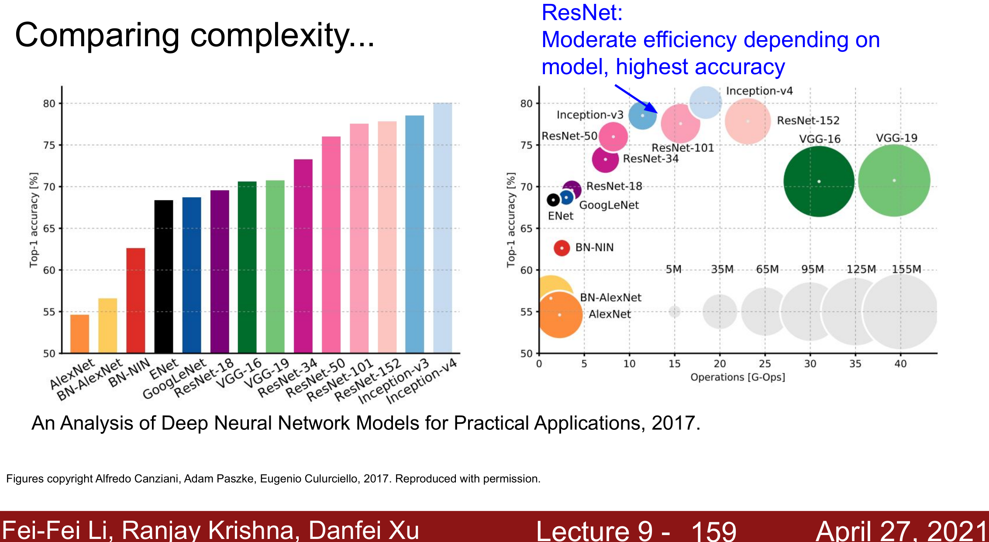

Slide 11
Deep Learning for Computer Vision by Justin Johnson, U-Michigan 2019
https://web.eecs.umich.edu/~justincj/teaching/eecs498/FA2020/schedule.html
Videos (2019) https://youtube.com/playlist?list=PL5-TkQAfAZFbzxjBHtzdVCWE0Zbhomg7r
- Lecture 10 &11 for various techniques for learning

Slide 12
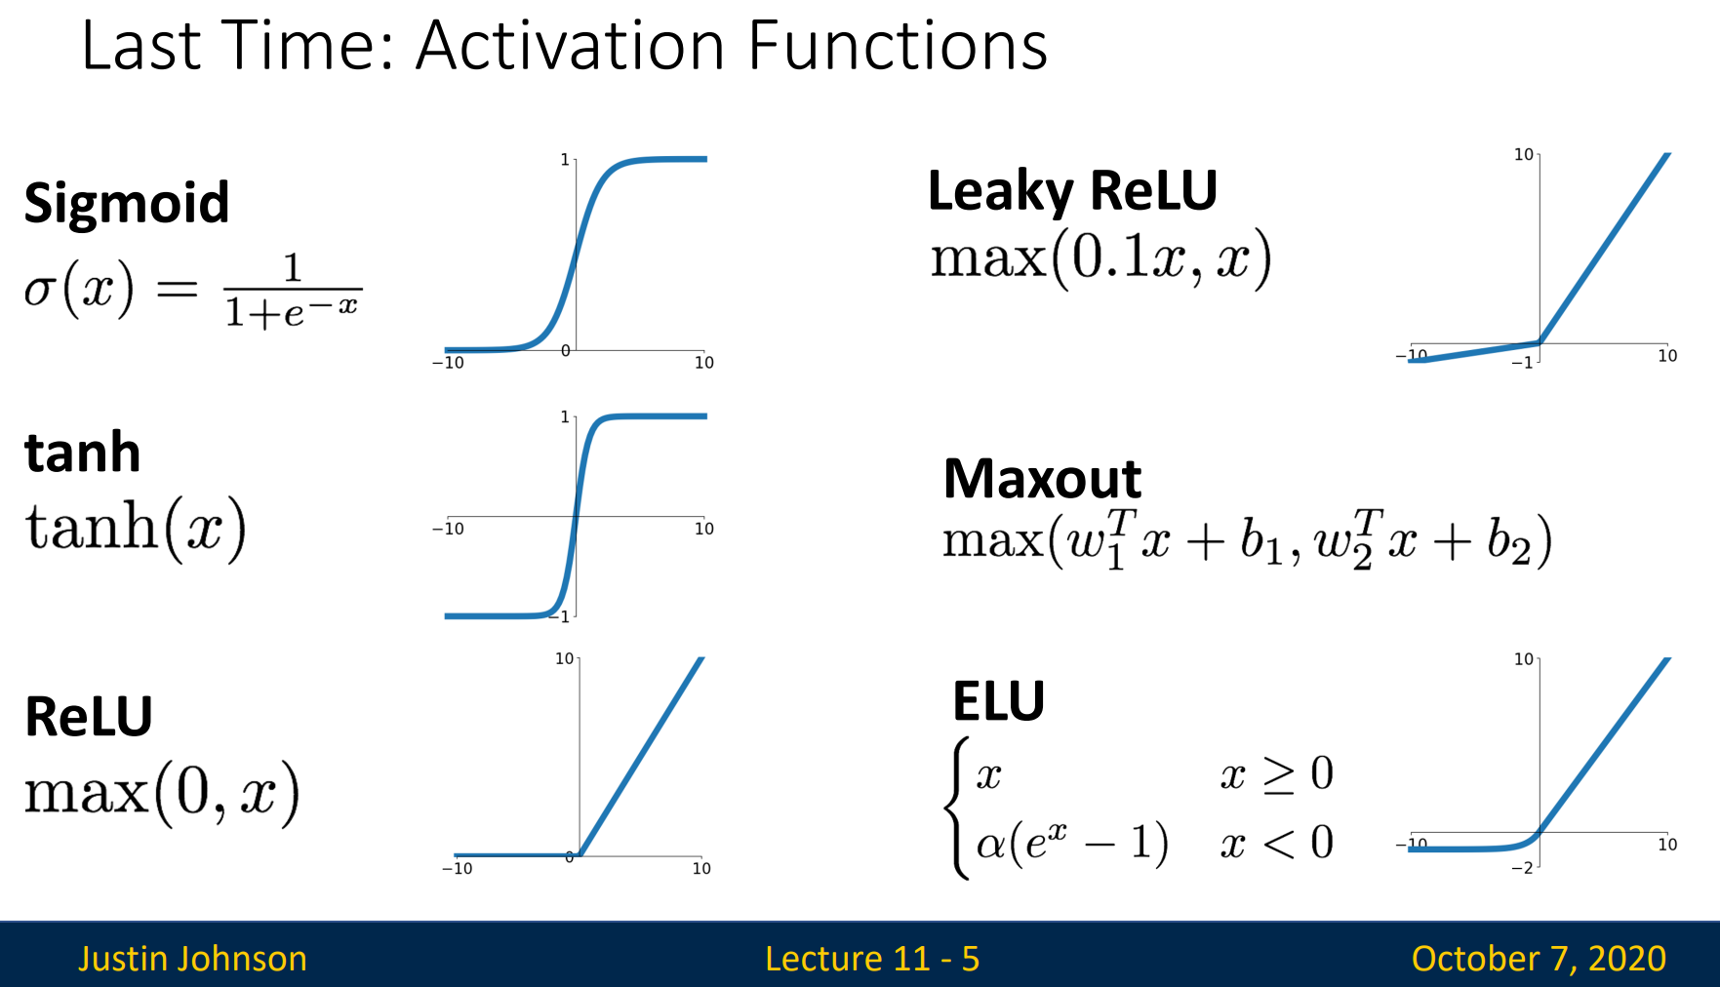

Slide 13
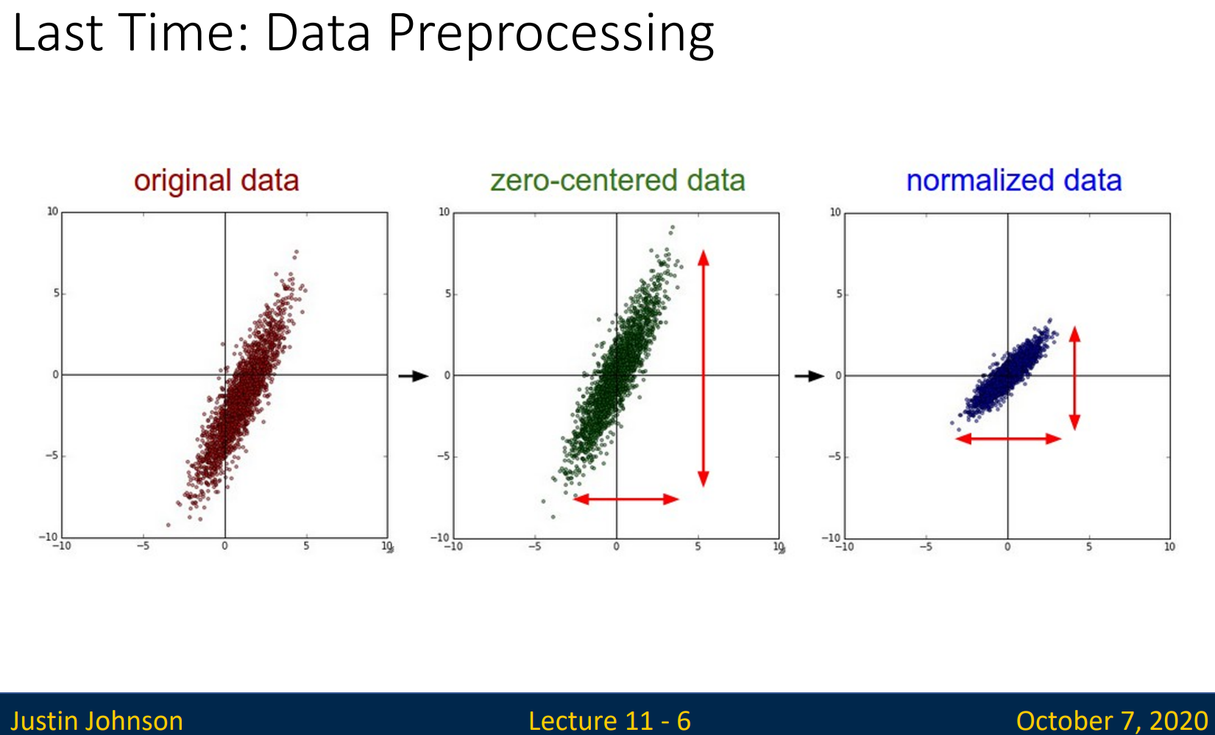

Slide 14
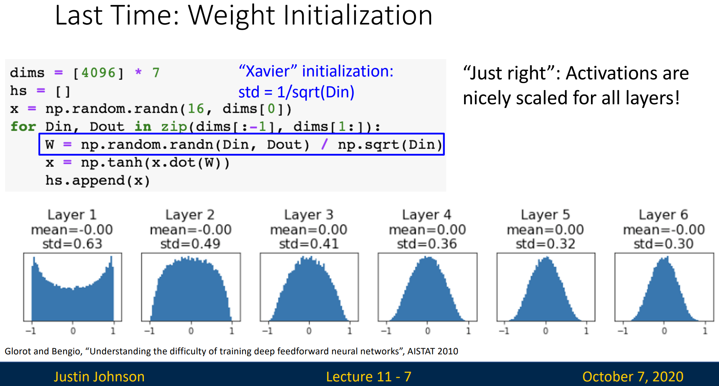

Slide 15
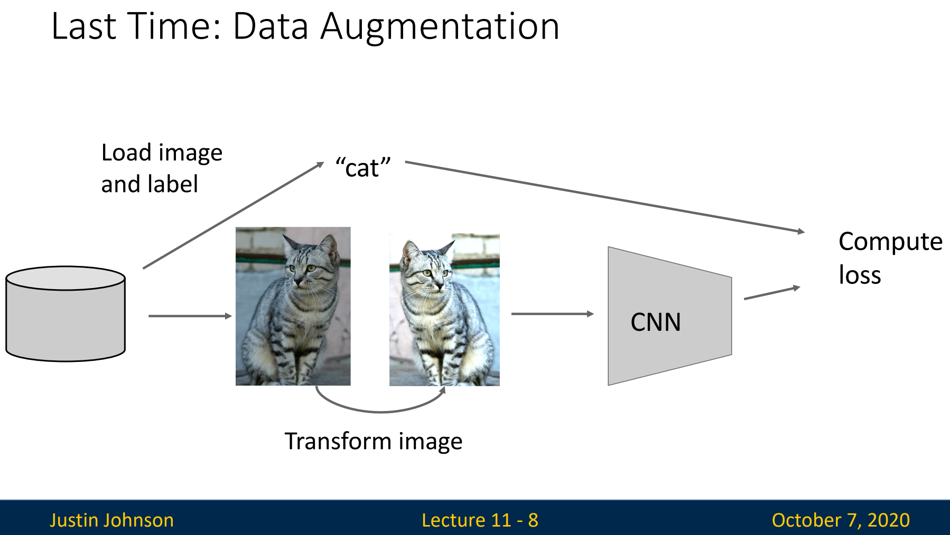

Slide 16
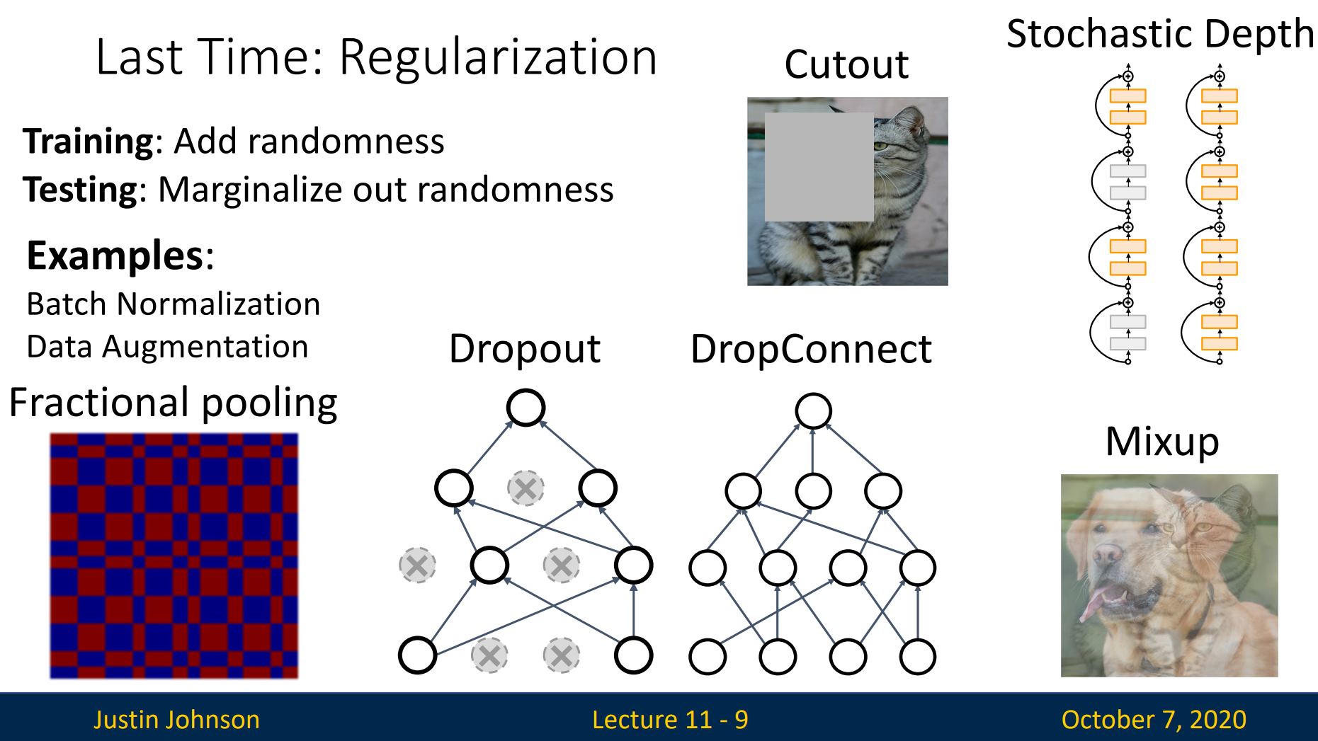

Slide 17
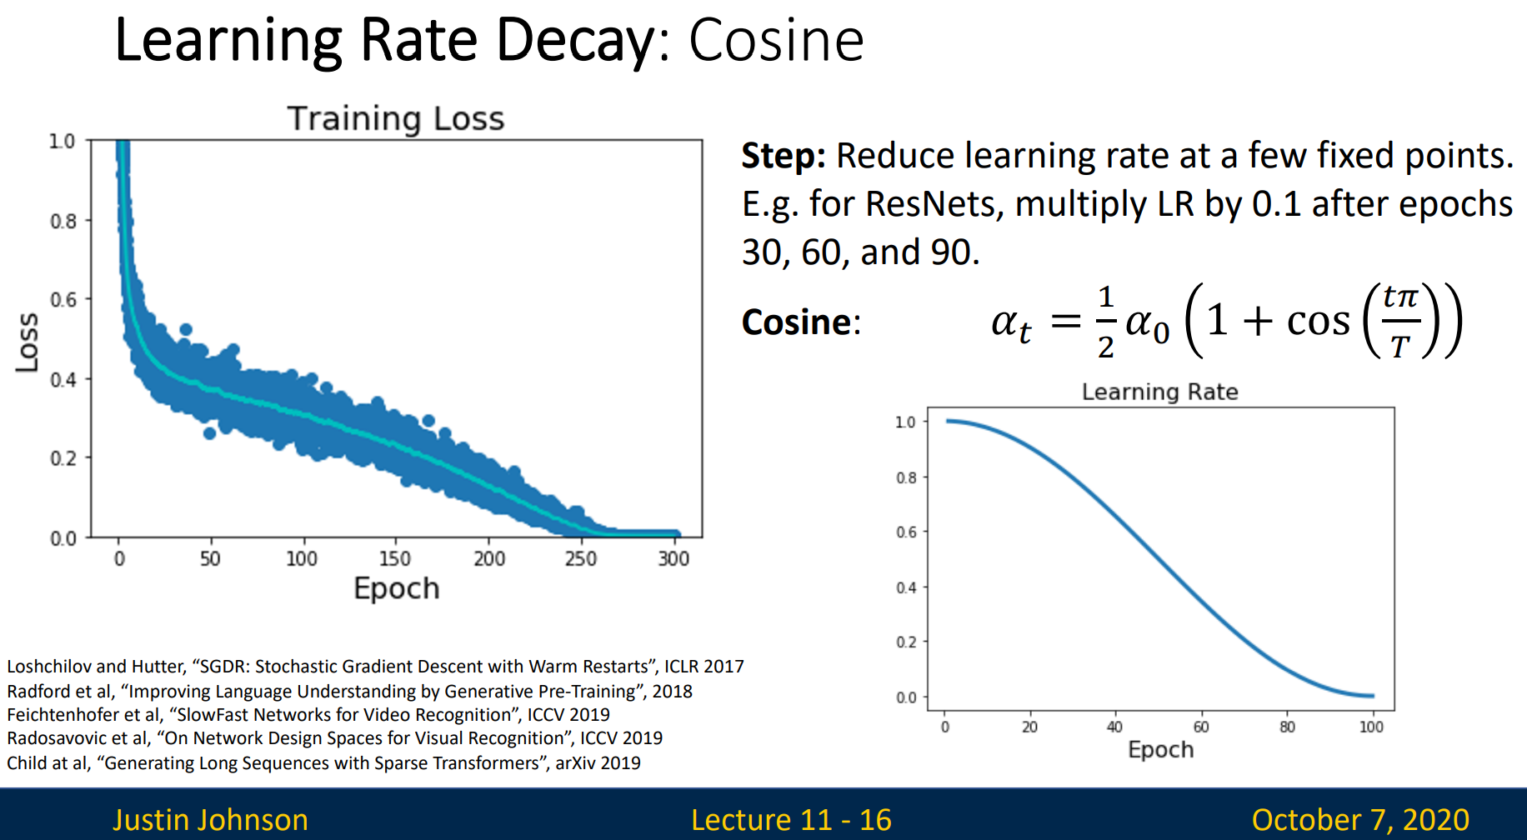

Slide 18
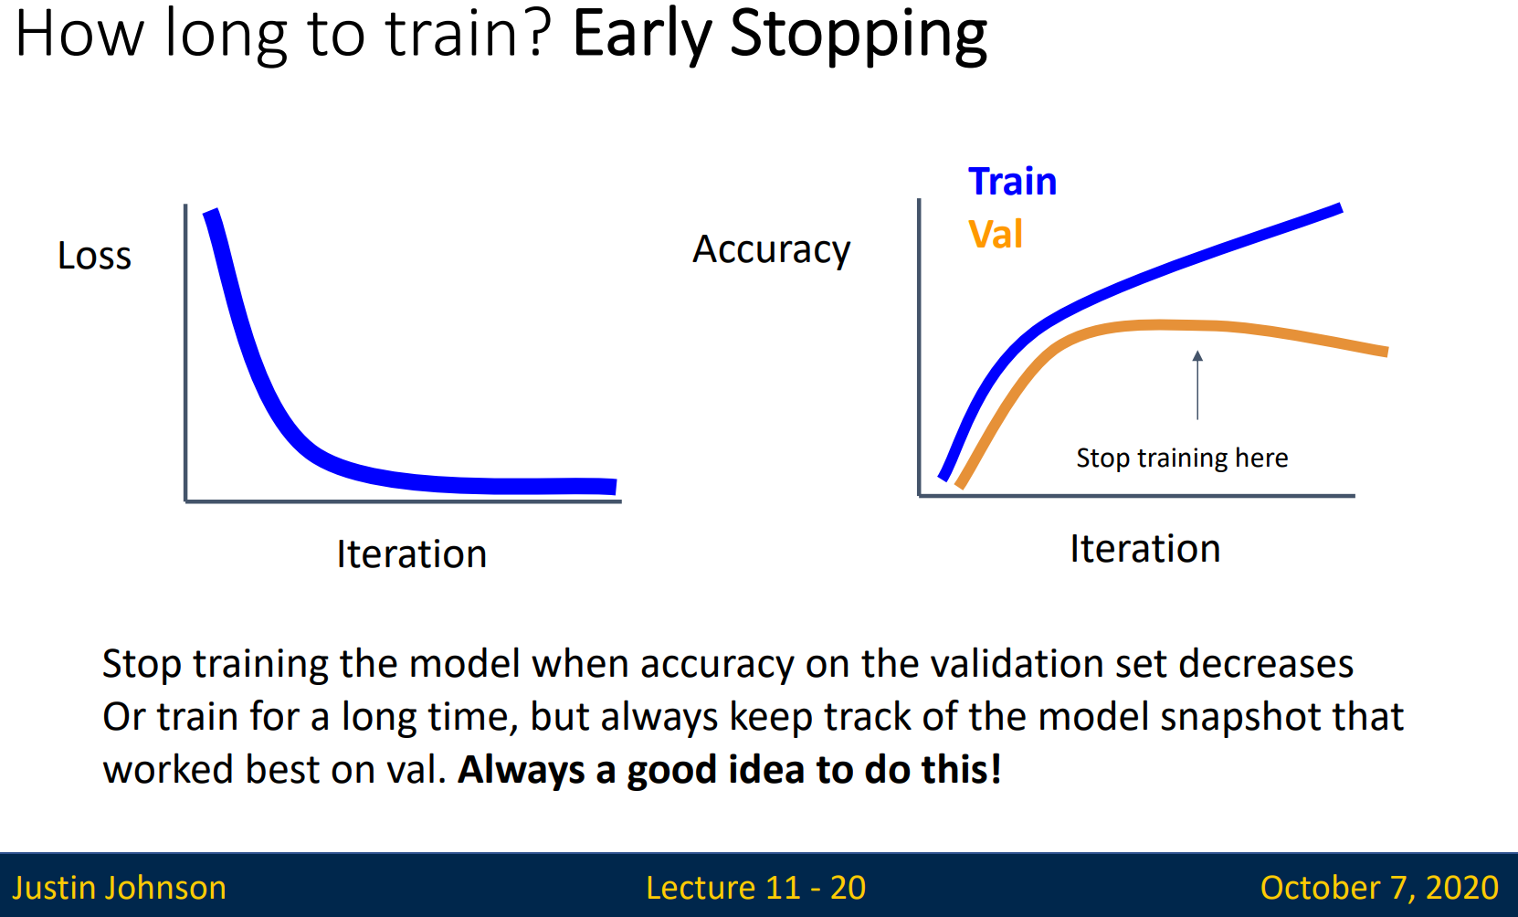

Slide 19
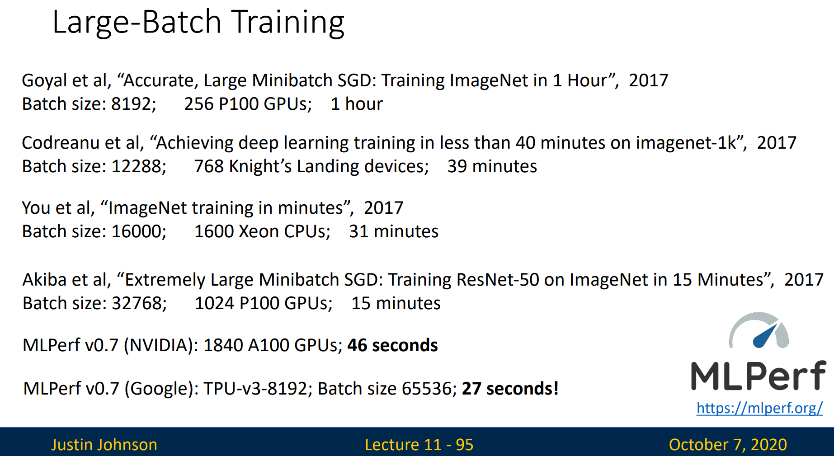

Slide 20
End.

